Slide 1
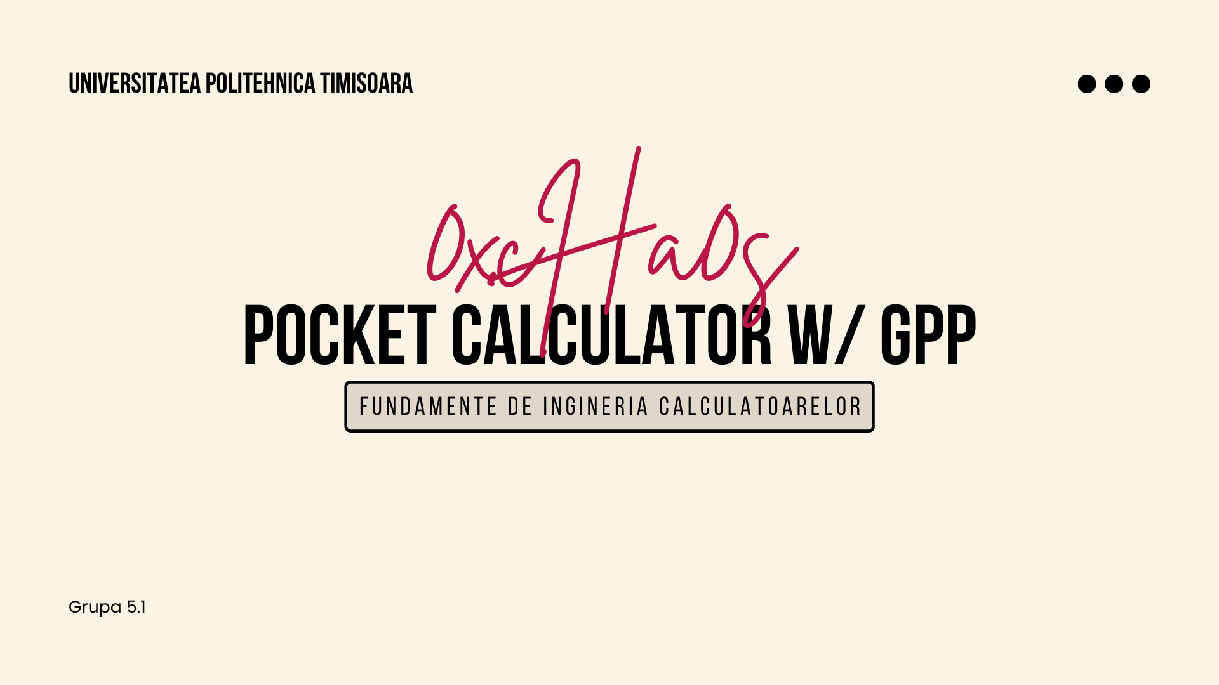

Slide 2

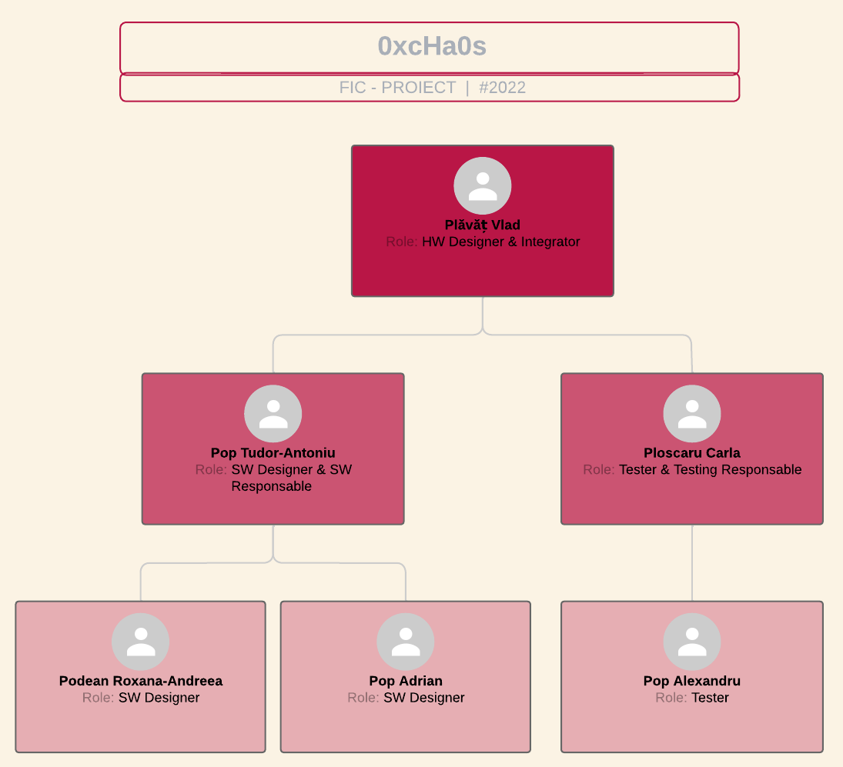
Our Team

Slide 3
Project Topic
ALU
Control Unit
Instruction & Data Memory
Sign Extend Unit
Processor Registers: PC, SP, Flag
Registers:
16-bit Accumulator
2 16-bit general purpose registers: X and Y
4-bit Flag register: Zero, Negative, Carry, Overflow
16-bit stack pointer
Program Counter

Slide 4
Instruction Set
Memory Instructions:
LOAD, STORE into registers X or Y
Instr. Type | Opcode | Register Address | Immediate
Memory | 6 bit | 1 bit | 9 bit
Branch | 6 bit | 10 bit | -
ALU | 6 bit | 1 bit | 9 bit
Branch Instructions:
BRZ = branch if zero
BRN = branch if negative
BRC = branch if carry
BRO = branch if overflow
BRA = branch always (unconditional branch)
JMP = call procedure
RET = return from procedure
Arithmetic and Logic Instructions:
ADD, SUB, LSR, LSL, RSR, RSL, MOV, MUL, DIV,
AND, OR, XOR, NOT, CMP, TST, INC, DEC, MOD

Slide 5
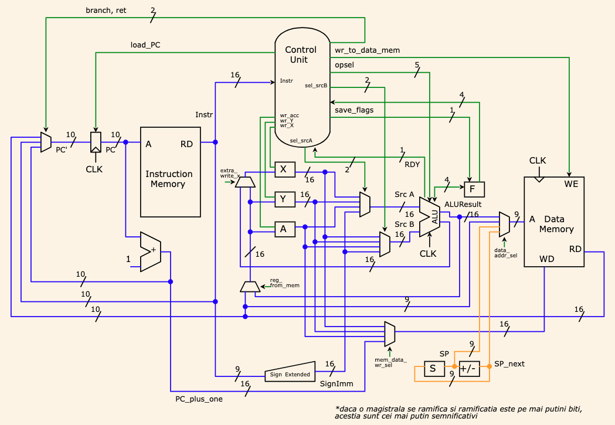
Hardware
Design

Slide 6
Software Design
Verilog:
Modulul data_mem
Modulul instr_mem
Modulul cpu
Modulul SignExtend
Modulul controlUnit
Modulul ALU
Submodulele SQRT, POW, Multiplier & Divider
Assembler:
assembler.c
opcode_behavior.h

Slide 7

Testing
ControlUnit_testbench
ALU_testbench
pow_testbench
sqrt_testbench
top_module
main.bin

Slide 8
References
https://www.sciencedirect.com/topics/computer-science/general-purpose-processor
https://en.wikibooks.org/wiki/Embedded_Control_Systems_Design/Processors
https://www.fpga4student.com/2017/04/verilog-code-for-16-bit-risc-processor.html
https://github.com/vprabhu28/16-Bit-CPU-using-Verilog
https://www.european-processor-initiative.eu/general-purpose-processor/
https://www.quora.com/What-is-a-difference-between-general-purpose-processor-and-single-purpose-processor
https://en.wikipedia.org/wiki/History_of_general-purpose_CPUs

Slide 9


